Slide 1

Computer Applications to Behavioral Sciences
Dr. Jibo He
Wichita State University
hejibo@gmail.com
https://psychology-courses.appspot.com/

Slide 2

A text file can be thought of as a sequence of lines
touch-event-log-file.txt
[1403887977.463725] /dev/input/event1: 0003 0035 00000327
[1403887977.463729] /dev/input/event1: 0003 0036 00000257
[1403887977.463735] /dev/input/event1: 0003 003a 0000001d
[1403887977.463739] /dev/input/event1: 0000 0000 00000000
[1403887977.543884] /dev/input/event1: 0003 0035 0000032c
[1403887977.543891] /dev/input/event1: 0003 0036 00000245
[1403887977.543895] /dev/input/event1: 0003 0030 00000004
[1403887977.543901] /dev/input/event1: 0000 0000 00000000
[1403887977.555953] /dev/input/event1: 0003 0036 00000242
[1403887977.555965] /dev/input/event1: 0000 0000 00000000

Slide 3

Before we can read the contents of the file we must tell Python which file we are going to work with and what we will be doing with the file
This is done with the open() function
open() returns a “file handle” - a variable used to perform operations on the file
Kind of like “File -> Open” in a Word Processor

Slide 4

handle = open(filename, mode)
  returns a handle use to manipulate the file
  filename is a string
  mode is optional and should be 'r' if we are planning reading the file and 'w' if we are going to write to the file.
fhand = open('touch-event-log-file.txt', 'r')
http://docs.python.org/lib/built-in-funcs.html

Slide 5

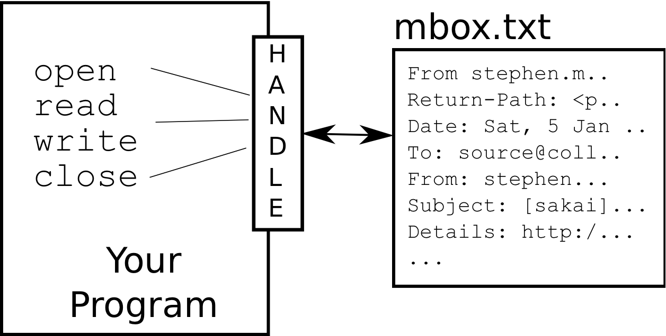
>>> fhand = open('touch-event-log-file.txt')
>>> print fhand
<open file 'touch-event-log-file.txt', mode 'r' at 0x1005088b0>
touch-event-log-file.txt

Slide 6

>>> fhand = open('stuff.txt')
Traceback (most recent call last): File "<stdin>", line 1, in <module>IOError: [Errno 2] No such file or directory: 'stuff.txt'

Slide 7

>>> stuff = 'Hello\nWorld!’
>>> stuff
'Hello\nWorld!’
>>> print stuff
Hello
World!
>>> stuff = 'X\nY’
>>> print stuff
X
Y
>>> len(stuff)
3
We use a special character to indicate when a line ends called the "newline"
We represent it as \n in strings
Newline is still one character - not two

Slide 8
A text file can be thought of as a sequence of lines
touch-event-log-file.txt
[1403887977.463725] /dev/input/event1: 0003 0035 00000327
[1403887977.463729] /dev/input/event1: 0003 0036 00000257
[1403887977.463735] /dev/input/event1: 0003 003a 0000001d
[1403887977.463739] /dev/input/event1: 0000 0000 00000000
[1403887977.543884] /dev/input/event1: 0003 0035 0000032c
[1403887977.543891] /dev/input/event1: 0003 0036 00000245
[1403887977.543895] /dev/input/event1: 0003 0030 00000004
[1403887977.543901] /dev/input/event1: 0000 0000 00000000
[1403887977.555953] /dev/input/event1: 0003 0036 00000242
[1403887977.555965] /dev/input/event1: 0000 0000 00000000

Slide 9
A text file has newlines at the end of each line
touch-event-log-file.txt
[1403887977.463725] /dev/input/event1: 0003 0035 00000327\n
[1403887977.463729] /dev/input/event1: 0003 0036 00000257\n
[1403887977.463735] /dev/input/event1: 0003 003a 0000001d\n
[1403887977.463739] /dev/input/event1: 0000 0000 00000000\n
[1403887977.543884] /dev/input/event1: 0003 0035 0000032c\n
[1403887977.543891] /dev/input/event1: 0003 0036 00000245\n
[1403887977.543895] /dev/input/event1: 0003 0030 00000004\n
[1403887977.543901] /dev/input/event1: 0000 0000 00000000\n
[1403887977.555953] /dev/input/event1: 0003 0036 00000242\n
[1403887977.555965] /dev/input/event1: 0000 0000 00000000\n

Slide 10

A file handle open for read can be treated as a sequence of strings where each line in the file is a string in the sequence
We can use the for statement to iterate through a sequence
Remember - a sequence is an ordered set
xfile = open('touch-event-log-file.txt')
for line in xfile:
print line

Slide 11

Open a file read-only
Use a for loop to read each line
Count the lines and print out the number of lines
fhand = open('touch-event-log-file.txt')
count = 0
for line in fhand:
count = count + 1
print 'Line Count:', count
$ python open.py

Slide 12

We can read the whole file (newlines and all) into a single string.
>>> fhand = open('touch-event-log-file.txt')
>>> inp = fhand.read()
>>> print len(inp)

Slide 13

We can put an if statement in our for loop to only print lines that meet some criteria
fhand = open('touch-event-log-file.txt')
for line in fhand:
if line.startswith('[') :
print line

Slide 14

'''
Jibo He @ WSU
demonstrate how to write a file.
September 24, 2014
'''
fhand = open('HelloWorld.txt','w')
print >>fhand,"Hello World"
fhand.close()

Slide 15
'''
Jibo He @ WSU
demonstrate how to write a file, print “Hello World” multiple times
September 24, 2014
'''
fhand = open('HelloWorld.txt','w')
for i in range(10):
print >>fhand,"Hello World"
fhand.close()

Slide 16

'''
Jibo He @ WSU
demostrate how to write a tab delimitated file.
September 24, 2014
'''
fhand = open('tabbedfile.txt','w')
for i in range(10):
print >>fhand,1,'\t',2,'\t',3
fhand.close()

Slide 17

Opening a file - file handle
File structure - newline character
Reading a file line-by-line with a for loop
Searching for lines
Write a file

